Slide 1

Austin Transportation Department Signs Work Orders
Created By: Susanne Gov Created Date: 2020-05-21 Location Name: 12TH ST / LUNA ST (Givens Park) Intersection ID: 5163091 Cardinal Direction: N
Sign Type | Install/Remove

Slide 2
Austin Transportation Department Signs Work Orders
Created By: Susanne Gov Created Date: 2020-05-21 Location Name: 12TH ST / LUNA ST (Givens Park) Intersection ID: 5163091 Cardinal Direction: S
Sign Type | Install/Remove

Slide 3
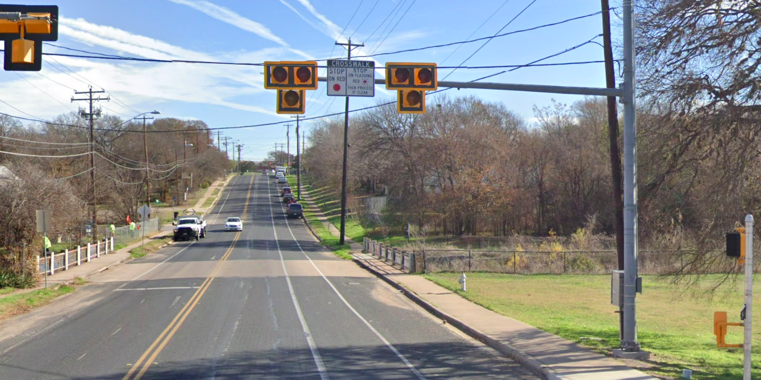
Austin Transportation Department Signs Work Orders
Created By: Susanne Gov Created Date: 2020-05-21 Location Name: 12TH ST / LUNA ST (Givens Park) Intersection ID: 5163091 Cardinal Direction: E
Sign Type | Install/Remove
Crosswalk Stop On Red | Install

Slide 4
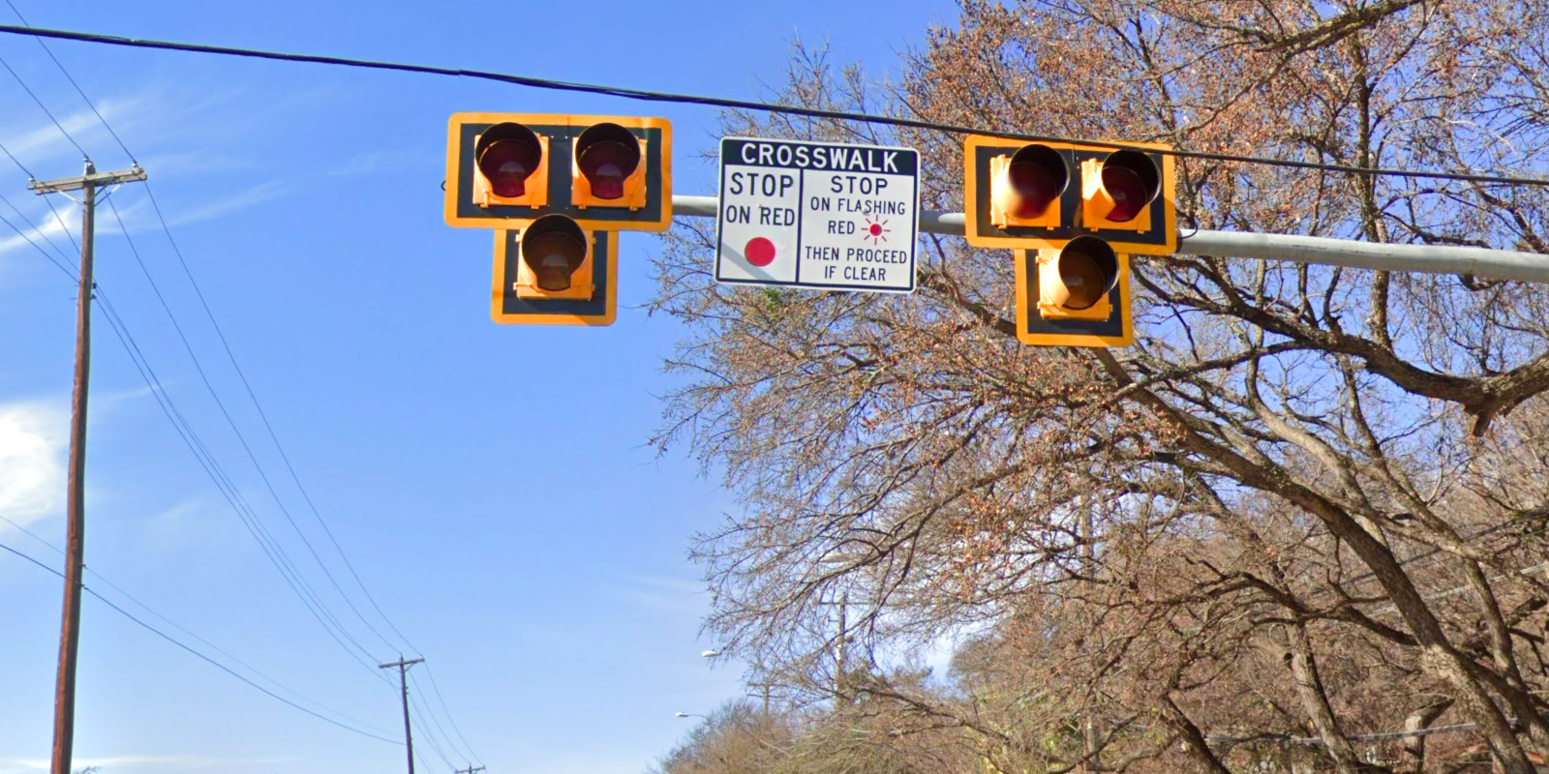
Austin Transportation Department Signs Work Orders
Created By: Susanne Gov Created Date: 2020-05-21 Location Name: 12TH ST / LUNA ST (Givens Park) Intersection ID: 5163091 Cardinal Direction: W
Sign Type | Install/Remove
Crosswalk Stop On Red | Install

